Slide 1
BMW AI use case for Check-in readings
July’2026

Slide 2
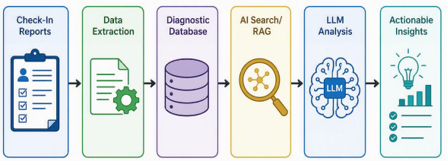
BMW AI use case for Check-in readings
Problem statement - We analyse automotive diagnostic report files containing DTCs and environmental data from various vehicle models and software releases. We manually review DTCs from my ECU i.e., UCAP-10 and related ECUs (like BCP, MGU etc.) to determine root causes. The process is repetitive, time-consuming and requires correlation across multiple ECUs and historical datasets.
Solution - We can leverage AI to automatically analyse large volumes of such reports, identify DTC trends across software releases, detect recurring issues after specific releases, correlate faults between interacting ECUs, and generate actionable diagnostic insights.
Technology - Python with additional packages like psycopg, pandas, PostgreSQL, AI LLM & RAG (yet to be identified)
Benefits -
Reduce analysis time from 20–30 minutes to under a minute
Automate DTC trend analysis across releases
Generate AI-assisted root cause recommendations
Correlate faults across interacting ECUs
Detect software regressions early
Enable predictive failure analysis
Scale for future service packs & can be used across different departments
Technical block diagram -
Tentative execution plan -
Step | Details | Status | Plan
1 | Create dummy check-in files | Completed
2 | Develop initial python parser that can store important check-in fields into a CSV file | Completed
3 | Install the PostgreSQL DB & enhance the python script to push the data into DB | Partially completed | Tentative – 22nd July 2026
4 | Verify that the database is responding as expected for the different queries | Pending | Tentative – 24th July 2026
5 | Develop AI knowledge base for DTC definitions, ECU interactions etc. | Pending | Tentative – 28th July 2026
6 | Use LLM with RAG to get diagnostics insights | Pending | Tentative – 31st July 2026

Slide 3

GET THE FUTURE YOU WANT
capgemini.com

